Slide 1
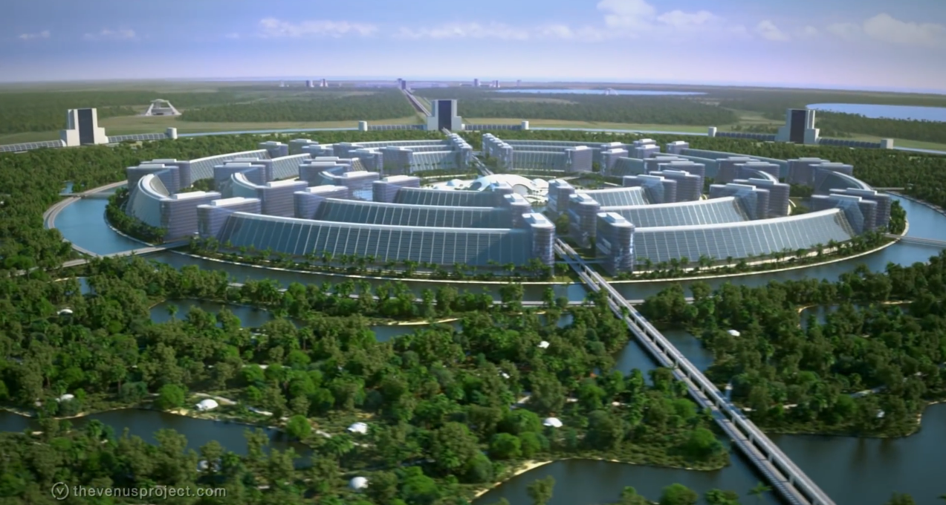
VENUS PROJECT
The Choice is Ours

Slide 2

About Us
BEYOND POLITICS, POVERTY & WAR
The Venus Project is an organization that proposes a feasible plan of action for social change, one that works towards a peaceful and sustainable global civilization. It outlines an alternative to strive toward where human rights are no longer paper proclamations but a way of life.
The Venus Project presents a bold, new direction for humanity that entails nothing less than the total redesign of our culture. Our proposition is not an attempt to predict what will be done, only what could be done. The responsibility for our future is in our hands, and depends on the decisions that we make today. The greatest resource that is available today is our own ingenuity.

Slide 3
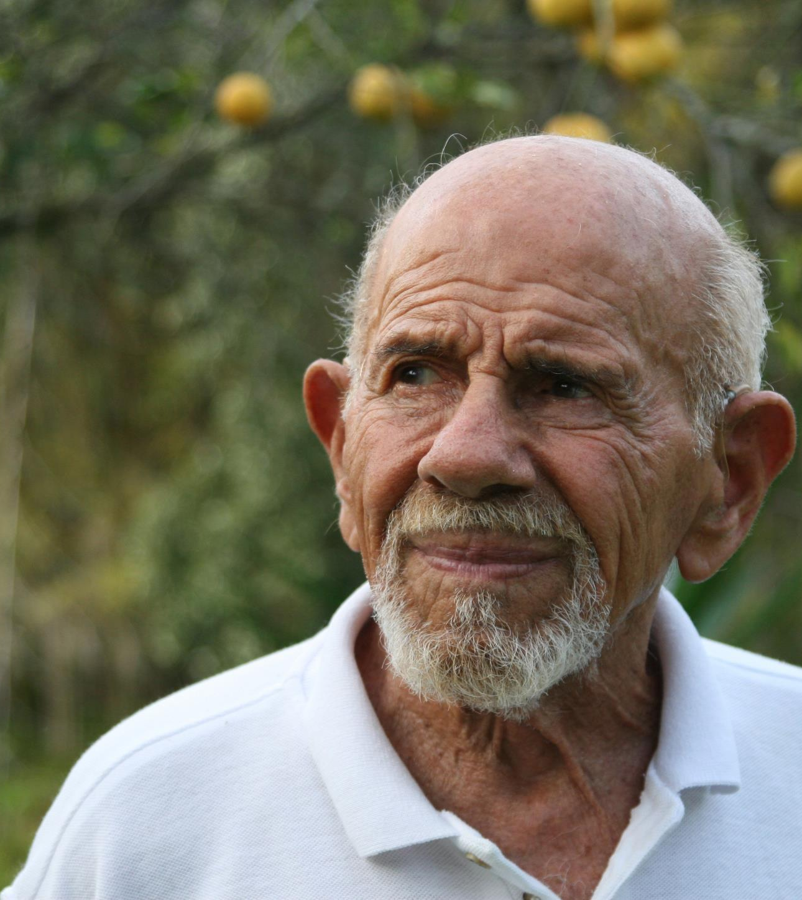
Jacque Fresco
Founder of the Venus Project
Born: 13 March 1916 (age 101 years), Brooklyn, New York City, New York, United States
Jacque Fresco’s background includes industrial design and social engineering, as well as being a forerunner in the field of Human Factors. Mr. Fresco has worked as both designer and inventor in a wide range of fields spanning from biomedical innovations to totally integrated social systems.
The Venus Project reflects the culmination of Mr. Fresco’s life work: the integration of the best of science and technology into a comprehensive plan for a new society based on human and environmental concern. It is a global vision of hope for the future of humankind in our technological age.

Slide 4
Analysis
9 billion!
With the increasing need of the resources and failing to restore the used ones, we face with yet another problem.
7 billion
35%
2012
2040
Population
We are depleting the natural resources 50% faster than the planet can renew. At this rate, we’ll need 3 more planet earth to keep our resource needs as they are today.

Slide 5
Climate Change & “The Sixth Extinction”
And yet , from environmental disaster to war, our obsolete value system perpetuate insanity, threatening us on many fronts.
Is it the best we can do to just clean up after the fact?
Are politicians capable or even competent to manage the world around us?
Are we simply incapable of anticipating and planning for our future?
Are we maybe flawed in ways we can’t change?

Slide 6
The Determinants of
Behaviour

Slide 7
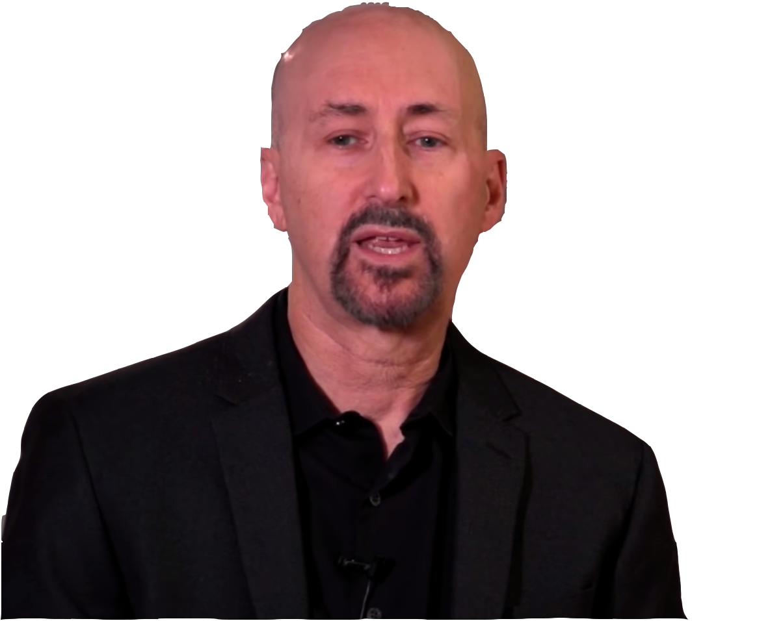
Technology impacts human life . We need Technology of Behaviour
“I have 3 children & they were all raised in the same environment & they all turned out to be different from each other”
“I think the most parsimonious explanation we can have for what constitutes beauty to a given individual has to come from that individual’s environments; the culture they’re raised in”
The notions of aesthetics & beauty.
Jacque Fresco
“If you marry the most beautiful girl in the world & then she became a pain in the butt, then that face become ugly to you. Beauty is all projection. There is no actual beauty”
Henry, Schilinger Jr., PhD
Dept. of Psychology – Cal State University

Slide 8
Don’t Judge based on Genes!
“Your father is in jail. How can I trust you?”
“He’s the son of that great person. He must be so good”
Research shows that learning also changes the physical and chemical structure of the brain. Obviously, may factors come into matter, but genes play a small role in comparison to the effects of the overall environment on how we learn.
We don’t change our minds. Our minds are changed by events. (wright brothers)
Their behaviour is shaped by the culture they’re brought up in.
Eg: New York crime rate, gangster, murderer | by associating with people that way

Slide 9

MONEY = CORRUPTION
As a remnant of Antiquity, money now largely serves as a mechanism of corruption, deprivation and control in the hands of a few.
Jacque Fresco
Henry Ford
- “It was difficult for early forms of life to crawl out of the primordial slime without dragging some of it with them.”
“It is well enough that people of the nation do not understand our banking and money system, for if they did, I believe there would be a revolution before tomorrow morning”
In a desperate attempt to survive, many work multiple jobs. They may steal, lie, or embezzle. On a bigger scale, the profit motive creates a ruthless cycle of devastation. Illness, pollution and war are accepted as normal.
Abby Martin
“It’s corrupted everything. Every institution that we live in is corrupted by money.
What’s fascinating is that we can become enslaved by something that we’ve created, not physically, but mentally enslaved by a notion that was invented by humanity”
Powerful People
But it does benefit the few at the top who live parasitically by the manipulation and control of money.

Slide 10
Banking System in Reality
Dylan Ratigan – dylanratigon.com
“The banking system right now is effectively enslaving individuals, enslaving students, enslaving institutions and sucking resources from them”
Karen Hudes – Economist, Lawyer & World bank Whistle-blower
“They set it up so that there would be private central banks that could charge everybody interest on the currency & allow themselves to get rich without having to do anything”
President Woodrow Wilson 1916
“A great industrial nation is controlled by its system of credit. Our system of credit is concentrated. The growth of the nation, therefore, and all our activities are in the hands of a few men. We have come to be one of the worst ruled, one of the most completely controlled and dominated governments in the civilized world…a government by the opinion and the duress of small groups of dominant men”

Slide 11
Fractional Reserve Lending
VIDEO NOT EMBEDDED FOR UPLOADING PURPOSES

Slide 12
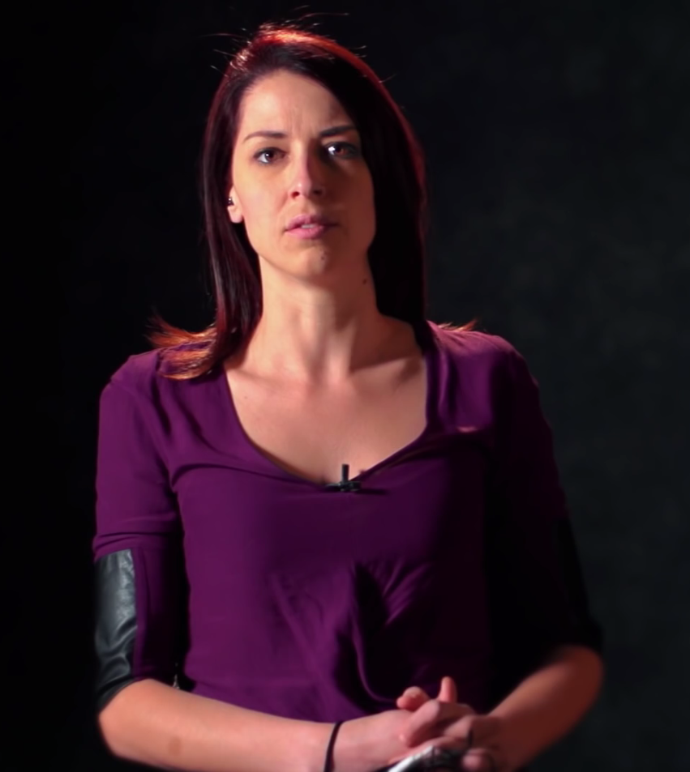





Abby Martin
Journalist & Host
Breaking the Set - RT
“The media is morphed into just peddling the corporate interests of the money masters that control the political establishment. There’s about 118 boards of directors that sit on these 5 giant media corporations. [News Corporation, COMSAT, Time Warner Cable, CBS, VIACOM]. They all serve different boards, from Monsanto, to weapons, to food…So, when you have all these interests bleeding together, it’s that much harder to differentiate what interests you’re seeing laid out in the mainstream media”

Slide 13
NOMINATING PROCESS
VIDEO NOT EMBEDDED
FOR UPLOADING PURPOSES
If you want to understand power, you have to understand who nominates candidates, not understand who votes for candidates.
The percentage of population that participates in the nomination process is literally less than 5% of the population & really less than 1% of the population.

Slide 14
Is the Earth the Insane Asylum of the Universe?
It is probable that war itself could be our undoing let alone the environment. Our brutal competitive behaviour are not human nature, but simply a result of scarcity making us all competitors in the fight to attain what we need to survive.
While scarcity is naturally occurring, it’s also intentional in industries and governments for profit & national interest.
As long as nations are immersed in scarcity, we will continue to have conflicts between people. Crimes, murder and other violence to all-out war, the ultimate expression to human stupidity.
And with our technological ability to provide for all, we must take step towards a different approach. Or the endless cycle of booms, busts & war will continue.

Slide 15
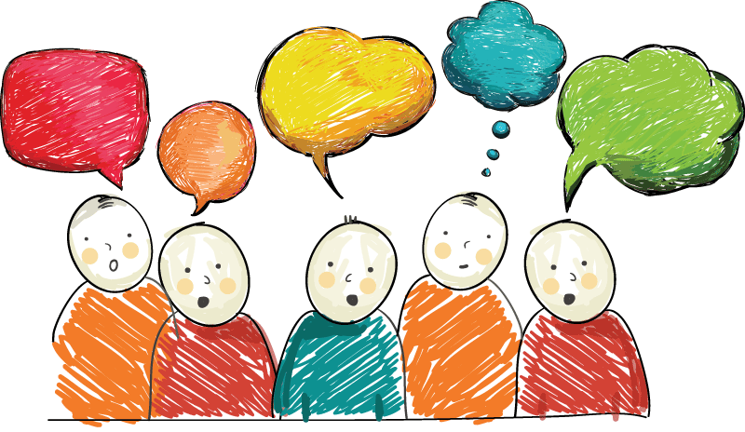
Opinion
“people have opinion about everything
there'll always be war,
there always has been war
because man is greedy”
- Jacque Fresco
In general, an opinion is a judgment, viewpoint, or statement that is not conclusive. It may deal with subjective matters in which there is no conclusive finding. What distinguishes fact from opinion is that facts are more likely to be verifiable, i.e. can be agreed to by the consensus of experts. An example is: "United States of America was involved in the Vietnam War" versus "United States of America was right to get involved in the Vietnam War".

Slide 16
Greed
People are reinforced in this culture to be greedy.
Greed is brought about by scarcity.
“Greed is a bottomless pit which exhausts the person in an endless effort to satisfy the need without ever reaching satisfaction” - Erich Fromm
70%
55%
85%
76%
92%
Land
Food
Land in never enough for humans.
Human Evolves in such a way that
they consume more food
Oil
Money
food
oil
security
money
Countires fight for oil to utilize
them for future purposes
More the money, better the satisfaction
land
Security
Job security and position also never is enough

Slide 17
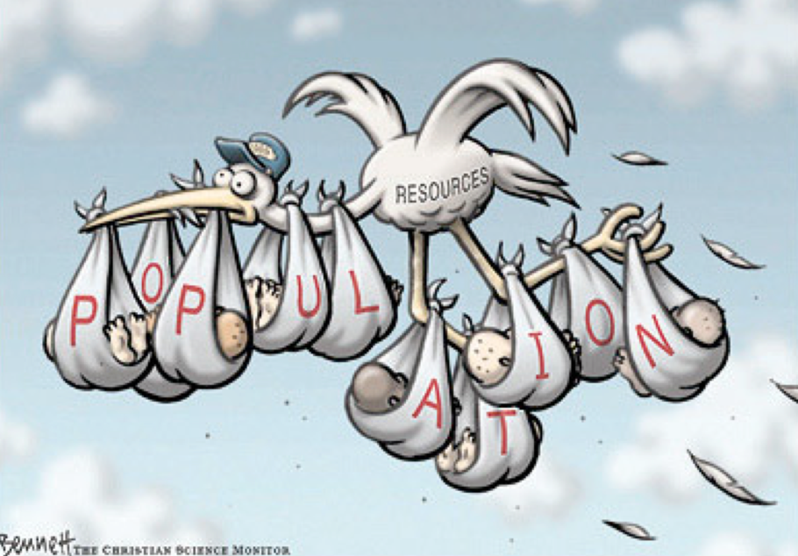
Scarcity
“Time is the scarcest resource and unless it is managed, nothing else can be managed “ -Peter Drucker
Scarcity (also called paucity) is the fundamental economic problem
of having seemingly unlimited human wants in a world of limited resources. It states that society has insufficient productive resources to fulfil all human wants and needs.
Venus is trying to eliminate scarcity and produce abundance.

Slide 18
CREATIVITY
creativity is taking known systems and putting together in unique ways
If you study the history of invention, you’ll see a relationship and tie of all these variables.
INTELLIGENCE
Intelligence has been defined in many different ways including as one's capacity for logic, understanding, self-awareness, learning, emotional knowledge, planning, creativity and problem solving.
the ability to extract significant information from any situation.

Slide 19
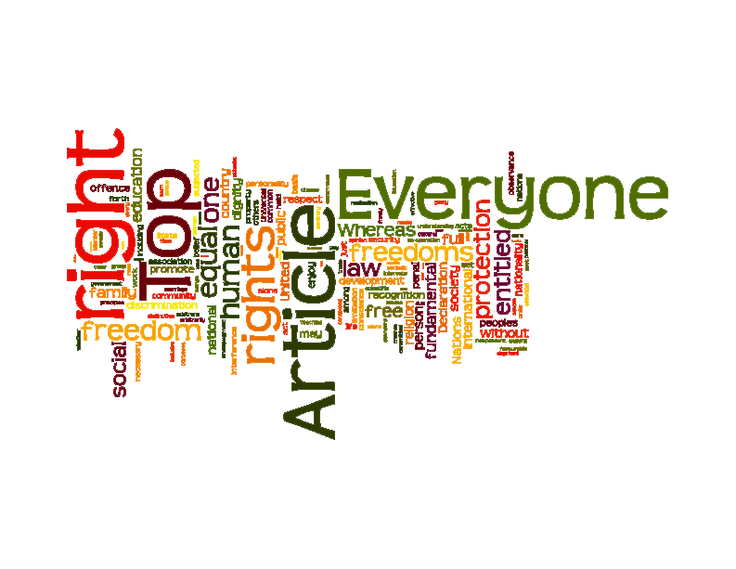
Human Rights
Will it be a democracy?
Did you vote for space program?
did you vote for the building of warships?
Did you vote for any wars?
In a world where democracy & freedom does exist, there are no proclamations as to human rights Its built into the system.
Morality
Morality can be a body of standards or principles derived from a code of conduct from a particular philosophy, religion, or culture, or it can derive from a standard that a person believes should be universal.

Slide 20
Loyalty to methodology
we don't want people to have loyalty to corporation, or a country we want them to have loyalty to methodology and loyalty to invention, meaning to improve everything that exists to make them better , smarter, faster
Loyalty to the earth and to all the people on it. And to make the earth a far better place than it is
Outdated concepts of Motivation
Financial gain is the main motivation for people. It is that people are interested in money
But actually what motivate people A world without war, poverty, hunger, loss of employment, loss of income.
VIDEO NOT EMBEDDED
FOR UPLOADING PURPOSES

Slide 21

Thank You

